Slide 1
COMP 3400
Week 7 - Wednesday

Slide 2
Last time
What did we talk about last time?
Started TCP programming: HTTP

Slide 3
Questions?

Slide 4
Project 2

Slide 5
TCP Socket Programming

Slide 6
Sample request
HTTP requests and responses start with header lines
  Each ends with CRLF (\r\n), with an extra CRLF after all headers
  Each \r\n would simply look like a newline, but we show them below for clarity
The most common client request is GET
It must have a line like the following:
  path is the file being requested
  version is the HTTP version, usually 1.0, 1.1, or 2
GET /path HTTP/version\r\n
GET /index.html HTTP/1.0\r\n
Accept: text/html\r\n
Accept-Encoding: gzip, deflate, br\r\n
Accept-Language: en-US,en;q=0.5\r\n
User-Agent: Mozilla/5.0\r\n
\r\n

Slide 7
netcat
In order to test clients and servers, it's useful to have a program that allows a text-only TCP connection
netcat is a common one
  Installed as executable nc on the Ubuntu machines in the lab
The first line below connects to example.com on port 80
The next three lines are header lines typed by the user
Lines marked in green are responses from the server
$ nc –v example.com 80
GET / HTTP/1.1
Host: example.com
Connection: close
HTTP/1.1 200 OK
…

Slide 8
Doing it in code
Once you've created a client socket and successfully connected to a server using the address information from the last class, you can send this data in code by creating a string
  snprintf() is also a good choice for arbitrarily formatted data
size_t length = 500;
char buffer[length + 1];
memset (buffer, 0, sizeof (buffer));
// Copy first line and shrink remaining length
strncpy (buffer, "GET /web/index.html HTTP/1.0\r\n", length);
length = 500 - strlen (buffer);
// Concatenate each additional header line
strncat (buffer, "Accept: text/html\r\n\r\n", length);
length = 500 - strlen (buffer);
write (socketfd, buffer, strlen (buffer)); // Send over socket

Slide 9
Sample response
After sending that data, the response will look something like the following:
HTTP/1.1 200 OK\r\n
Content-Type: text/html; charset=UTF-8\r\n
Date: Sun, 28 Feb 2021 22:20:28 GMT\r\n
Content-Length: 1256\r\n
Connection: close\r\n
\r\n
<!doctype html>\n
<html>\n
<head>\n
<title>Example Domain</title>\n
</head>\n
<body>\n
<div>\n
<h1>Example Domain</h1>\n
<p>This domain is for use in illustrative examples in documents.</p>\n
</div>\n
</body>\n
</html>\n

Slide 10
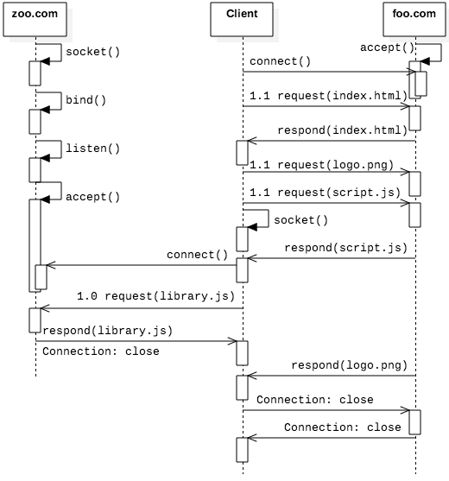
Persistent connections
HTTP/1.0 was one and done
HTTP/1.1 allows for persistent connections, so that multiple requests can be made over the same TCP connection
HTML that requires multiple requests is below
The sequence diagram showing the communication is on the right
<html>
<head>
<script src="http://zoo.com/library.js" />
<script src="script.js" />
</head>
<body><img src="logo.png" /></body>
</html>

Slide 11
HTTP headers
A successful response to an HTTP request usually starts with:
But there are many other common status codes:
HTTP/1.1 200 OK
Status | Text | Explanation
200 | OK | Request was successful
301 | Moved Permanently | File has been moved to a new location
400 | Bad Request | The HTTP request had incorrect syntax
401 | Unauthorized | The request requires user authentication
403 | Forbidden | Access to the resource is not allowed
404 | Not Found | No file was found based on Request-URI
500 | Internal Server Error | The server had an unexpected error or fault
503 | Service Unavailable | The server is unavailable or not accepting new requests

Slide 12
Receiving headers
Sending headers is easy because you know how much data you've got
Receiving is harder, requiring a fixed length buffer with what you hope is plenty of room
#define HEADER_MAX 8192
// Allocate a buffer to handle initial responses up to 8 KB
char buffer[HEADER_MAX + 1];
ssize_t bytes = read (socketfd, buffer, HEADER_MAX);
assert (bytes > 0);
// If we can't find the CRLFCRLF, the header was too long
char *eoh = strnstr (buffer, "\r\n\r\n", HEADER_MAX);
if (eoh == NULL)
{
fprintf (stderr, "Header exceeds 8 KB maximum\n");
close (socketfd);
return EXIT_FAILURE;
}
// Replace the CRLF CRLF with \0 to split the header and body
eoh[2] = '\0';

Slide 13
Processing headers
After reading headers on the previous slides, we can look through each one
One critical thing is to find the length of the content, so we can allocate enough space for it
char *line = buffer;
char *eol = strstr (line, "\r\n");
size_t body_length = 0;
while (eol != NULL) // While there are more CRLFs
{
eol[0] = '\0'; // Null-terminate each line
printf ("HEADER LINE: %s\n", line);
// Find content length
if (! strncmp (line, "Content-Length: ", 16))
{
char *len = strchr (line, ' ') + 1;
content_length = strtol (len, NULL, 10);
}
line = eol + 2; // Move to the next line
eol = strstr (line, "\r\n");
}

Slide 14
Getting the content
On the previous slide, we found the length of the content
It's possible that the content was so small we read it into our 8 KB buffer
Otherwise, we'll need to allocate more space
int length = strlen(eoh + 4);
char *content = malloc(length + 1);
strcpy(content, eoh + 4);
if (content_length > length) // if false, all data received
{
// Increase the content size and read additional data
// Bytes needed is the Content-Length minus bytes already received
content = realloc (content, content_length);
bytes = read (socketfd, content + length, content_length - length);
}

Slide 15
UDP Socket Programming

Slide 16
UDP socket programming
As with TCP, it's hard to give meaningful examples of code without using some application-level protocol
For TCP, we did HTTP
For UDP, we'll do DNS
DNS, the Domain Name System, is the distributed network of servers that translates domain names into IP addresses

Slide 17
DNS
ICANN maintains the root structure of DNS
Below the root are top level domains (TLDs) like com, edu, org, net and a lot of weird newish ones like engineering and pink
Different companies manage each TLD
Domains can be looked up from the TLD that houses it
  edu knows where otterbein.edu can be found
  Dots separate each entity
It’s a kind of little endian ordering where the leftmost entity is the most specific, growing more general to the right
DNS is case insensitive
.
edu
com
org
otterbein
mit
microsoft
amazon
code

Slide 18
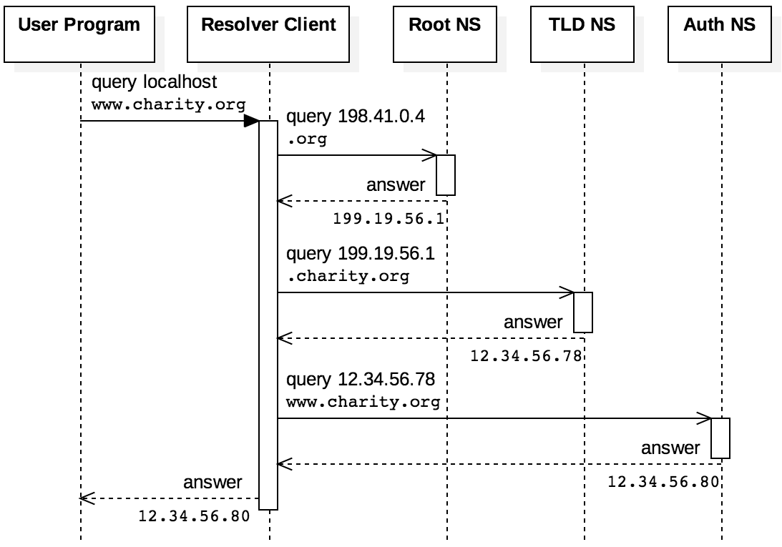
DNS queries
Queries can be iterative:
  Ask the root, get a response for the TLD
  Ask the TLD for the domain you want
  Get a response closer to what you're looking for and repeat
  Shown on the right
Queries can also be recursive:
  Ask a name server, it handles everything
To make the system efficient, servers cache domains that have been asked for recently
There's a time-to-live value that says how long a cached domain should be kept

Slide 19
DNS resource record structure
DNS information is sent in resource records, which have the following form:
  NAME is the human-readable domain name
  TYPE is gives the kind of record
    A is an IP address
    CNAME is a canonical name
    NS is an authoritative name server
  CLASS is what protocol, often IN for Internet
  TTL is time-to-live in a cache
  RDLENGTH is the length of the data in the record
  RDATA is the data
NAME and RDATA are variable length, and all other fields are 16 bits
NAME
TYPE
CLASS
TTL
RDLENGTH
RDATA

Slide 20
DNS requests
Like HTTP, DNS is a request-response protocol
Unlike HTTP, DNS uses UDP and messages aren't as human readable
DNS messages contain five fields: header, question, answer, authority, and additional
  Headers start with a random ID to keep messages straight
Example request to resolve example.com:
Field | Data in Hex | Meaning
Header | 1234 | XID=0x1234
 | 0100 | OPCODE=SQUERY
 | 0001 0000 0000 0000 | 1 question field
Question | 0765 7861 6d70 6c65 0363 6f6d 00 | QNAME=EXAMPLE.COM
 | 0001 0001 | QCLASS=IN, QTYPE=A
Answer
Authority
Additional
Note:
Instead of dots, QNAME gives the number of characters for each name part
Character | 7 | e | x | a | m | p | l | e | 3 | c | o | m | 0
Hex | 07 | 65 | 78 | 61 | 6d | 70 | 6c | 65 | 03 | 63 | 6f | 6d | 00

Slide 21
DNS responses
Here's a reasonable response to the request from the previous slide
Don't worry about the OPCODE, it's a set of bits laid out according to DNS rules
QNAME uses a special code to indicate that the name is 12 bytes into this response (to avoid repetition)
Field | Data in Hex | Meaning
Header | 1234 | XID=0x1234
 | 8180 | OPCODE=SQUERY, RESPONSE, RA
 | 0001 0001 0000 0000 | 1 question and 1 answer
Question | 0765 7861 6d70 6c65 0363 6f6d 00 | QNAME=EXAMPLE.COM
 | 0001 0001 | QCLASS=IN, QTYPE=A
Answer | c00c | QNAME=EXAMPLE.COM [compressed]
 | 0001 | QTYPE=A
 | 0001 | QCLASS=IN
 | 0000 e949 | TTL = 0xe949 = 59721
 | 04 | RDLENGTH = 4
 | 0x5db8d822 [93.184.216.34] | RDATA
Authority
Additional

Slide 22
Ticket Out the Door

Slide 23
Upcoming

Slide 24
Next time…
Finish UDP socket programming
Broadcasting

Slide 25
Reminders
Keep working on Project 2
Read sections 4.6 and 4.7

